Slide 1
Stack
Prepared By:
Tasmiah Tamzid Anannya, Lecturer, CS Dept, AIUB

Slide 2
Infix, Postfix and Prefix Expressions
INFIX: From our schools times we have been familiar with the expressions in which operands surround the operator, e.g. x+y, 6*3 etc this way of writing the Expressions is called infix notation.
POSTFIX: Postfix notation are also Known as Reverse Polish Notation (RPN). They are different from the infix and prefix notations in the sense that in the postfix notation, operator comes after the operands, e.g. xy+, xyz+* etc.
PREFIX: Prefix notation also Known as Polish notation. In the prefix notation, as the name only suggests, operator comes before the operands, e.g. +xy, *+xyz etc.

Slide 3
Examples of infix to prefix and postfix
Infix | PostFix | Prefix
A+B | AB+ | +AB
(A+B) * (C + D) | AB+CD+* | *+AB+CD
A-B/(C*D^E) | ABCDE^*/- | -A/B*C^DE

Slide 4
Operator Priorities
How do you figure out the operands of an operator?
a + b * c
a * b + c / d
This is done by assigning operator priorities.
priority(*) = priority(/) > priority(+) = priority(-)
When an operand lies between two operators, the operand associates with the operator that has higher priority.

Slide 5
Tie Breaker
When an operand lies between two operators that have the same priority, the operand associates with the operator on the left.
a + b - c
a * b / c / d

Slide 6
Delimiters
Subexpression within delimiters is treated as a single operand, independent from the remainder of the expression.
(a + b) * (c – d) / (e – f)

Slide 7
WHY
Why to use these weird looking PREFIX and POSTFIX notations when we have simple INFIX notation?
To our surprise INFIX notations are not as simple as they seem specially while evaluating them. To evaluate an infix expression we need to consider Operators’ Priority and Associative property
For example expression 3+5*4 evaluate to 32 i.e. (3+5)*4 or to 23 i.e. 3+(5*4).
To solve this problem Precedence or Priority of the operators were defined. Operator precedence governs evaluation order. An operator with higher precedence is applied before an operator with lower precedence.

Slide 8
Infix Expression Is Hard To Parse
Need operator priorities, tie breaker, and delimiters.
This makes computer evaluation more difficult than is necessary.
Postfix and prefix expression forms do not rely on operator priorities, a tie breaker, or delimiters.
So it is easier to evaluate expressions that are in these forms.

Slide 9
Both prefix and postfix notations have an advantage over infix that while evaluating an expression in prefix or postfix form we need not consider the Priority and Associative property (order of brackets).
E.g. x/y*z becomes
*/xyz in prefix and
xy/z* in postfix.
Both prefix and postfix notations make Expression Evaluation a lot easier.

Slide 10
Example: postfix expressions
Postfix notation is another way of writing arithmetic expressions.
In postfix notation, the operator is written after the two operands.
infix: 2+5 postfix: 2 5 +
Expressions are evaluated from left to right.
Precedence rules and parentheses are never needed!!

Slide 11
Postfix Examples
Why ? No brackets necessary !
Infix | Postfix | Evaluation
2 - 3 * 4 + 5 | 2 3 4 * - 5 + | -5
(2 - 3) * (4 + 5) | 2 3 - 4 5 + * | -9
2- (3 * 4 +5) | 2 3 4 * 5 + - | -15

Slide 12
When do we need to use them… ☺
So, what is actually done in expression is scanned from user in infix form; it is converted into prefix or postfix form and then evaluated without considering the parenthesis and priority of the operators.

Slide 13
Algorithm for Infix to Postfix
1. Scan the infix expression from left to right.
2. If the scanned character is an operand, output it.
3. Else, If the scanned character is an operator …..3.1 If the precedence of the scanned operator is greater than the precedence of the operator in the stack(or the stack is empty or the stack contains a ‘(‘ ), push it. …..3.2 Else, Pop all the operators from the stack which are greater than or equal to in precedence than that of the scanned operator. After doing that Push the scanned operator to the stack. (If you encounter parenthesis while popping then stop there and push the scanned operator in the stack.)
4. If the scanned character is an ‘(‘, push it to the stack.
5. If the scanned character is an ‘)’, pop the stack and and output it until a ‘(‘ is encountered, and discard both the parenthesis.
6. Repeat steps 2-6 until infix expression is scanned.
7. Print the output
8. Pop and output from the stack until it is not empty.

Slide 14
Suppose we want to convert infix: 2*3/(2-1)+5*3 into Postfix form,
Input (infix) | Stack | Output (Postfix)
2 | Empty | 2
* | * | 2
3 | * | 23
/ | / | 23*
( | /( | 23*
2 | /( | 23*2
- | /(- | 23*2
1 | /(- | 23*21
) | / | 23*21-
+ | + | 23*21-/
5 | + | 23*21-/5
* | +* | 23*21-/5
3 | +* | 23*21-/53
 | Empty | 23*21-/53*+
So, the Postfix Expression is 23*21-/53*+

Slide 15
Example
( 5 + 6) * 9 +3
will be
5 6 + 9 * 3 +
Conversion of infix to prefix: try it at home.

Slide 16
Algorithm for Infix to Prefix
Reverse the infix expression i.e A+B*C will become C*B+A. Note while reversing each ‘(‘ will become ‘)’ and each ‘)’ becomes ‘(‘.
Obtain the postfix expression of the modified expression i.e CB*A+.
Reverse the postfix expression. Hence in our example prefix is +A*BC.

Slide 17
Evaluation of a postfix expression
Each operator in a postfix string refers to the previous two operands in the string.
Suppose that each time we read an operand we push it into a stack. When we reach an operator, its operands will then be top two elements on the stack
We can then pop these two elements, perform the indicated operation on them, and push the result on the stack.
So that it will be available for use as an operand of the next operator.

Slide 18
Evaluating Postfix Notation
Use a stack to evaluate an expression in postfix notation.
The postfix expression to be evaluated is scanned from left to right.
Variables or constants are pushed onto the stack.
When an operator is encountered, the indicated action is performed using the top elements of the stack, and the result replaces the operands on the stack.

Slide 19
Algorithm: To evaluate a postfix value
Add “)” at the right end of the expression.
Scan p from left to right and repeat step 3 and 4 for each element of p until encountered “)”.
If an operand is encountered, PUSH it in stack.
If an operator  is encountered, then
To remove two element from stack Call POP() twice and first POP() put to A and second one to B.
Evaluate C = B  A.
PUSH(C) in stack.
Set the value = POP(), the top element of stack.
Exit

Slide 20
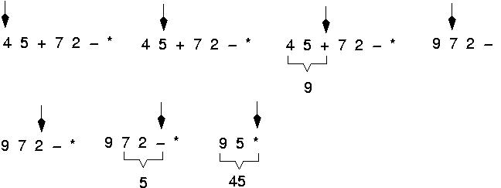
Example: postfix expressions (cont.)

Slide 21
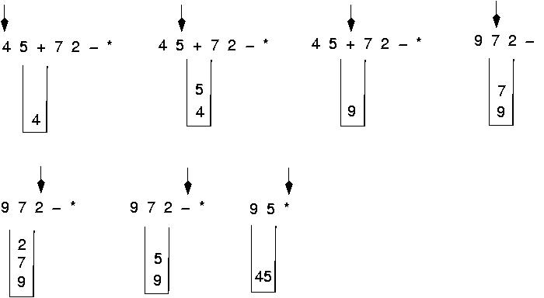
Postfix expressions: Algorithm using stacks (cont.)

Slide 22
Question : Evaluate the following expression in postfix : 623+-382/+*2^3+
Final answer is ?
49
51
52
7
None of these

Slide 23
Evaluate- 623+-382/+*2^3+ )
6
2
6
3
2
6
623+-382/+*2^3+)
65-382/+*2^3+) 1382/+*2^3+)
5
6
3
1
8
3
1
2
8
3
1
4
3
1
1

Slide 24
Cont. of Evaluation- 623+-382/+*2^3+
134+*2^3+) 17*2^3+)
72^3+) 493+)
= 52
4
3
1
7
1
7
7
2
7
49
3
49
52

Slide 26
Algorithm: To evaluate a prefix value
Add “(” at the left end of the expression.
Scan p from right to left and repeat step 3 and 4 for each element of p until encountered “(”.
If an operand is encountered, PUSH it in stack.
If an operator  is encountered, then
To remove two element from stack Call POP() twice and first POP() put to A and second one to B.
Evaluate C = A  B
PUSH(C) in stack.
Set the value = POP(), the top element of stack.
Exit

